Slide 1


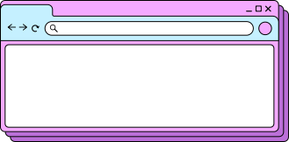
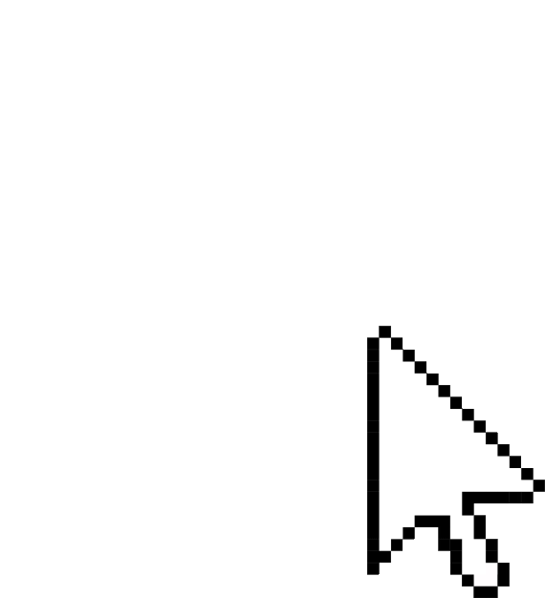
PORTFOLIO WEBSITE
Shamshad Shaikh

Slide 2


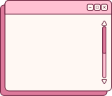
INSPIRATION
Other website
Kaziku-Art
UiVerse
https://kazuki-art.com/
https://uiverse.io/
I looked at other portfolio websites to give my self an idea on how make my website look aestheitc.
Vintage Vibe
Simple
Aesthetically pleasing
Aestheic elements to use for my website.

Slide 3


Planning
RESEARCH
Search about different portfolios and the layouts and the color schemes to use and what vibe to go for.
Mock up
Did a mock up on Miro so i don't get confuse when im coding.
Tutorials
looked at tutorials on how to use html and css.

Slide 4
Miro

Slide 5
Final Outcome

Slide 6
QUESTIONS ?

Slide 7



i dont really know
Contact
Sham.Archives_
the world

